Slide 1
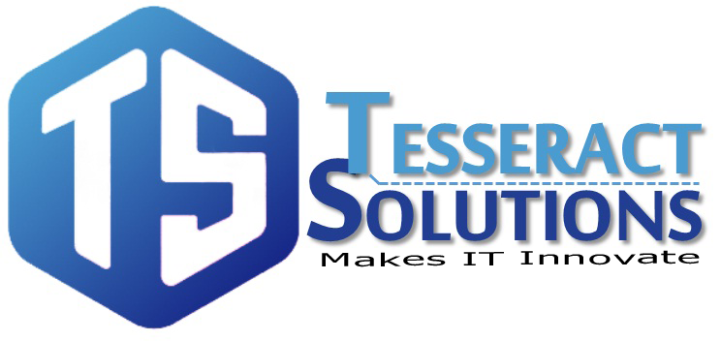
https://www.facebook.com/tesseractspl
https://www.linkedin.com/company-beta/11222535/

Slide 2
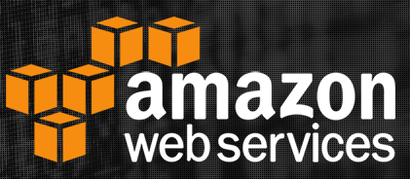
Route53

Slide 3

AGENDA
Introduction
What is DNS?
Features
Routing Policies
Weighted Routing Policy
Latency Based Routing Policy
Failover Routing Policy
Geolocation Routing Policy
Working of Route 53

Slide 4
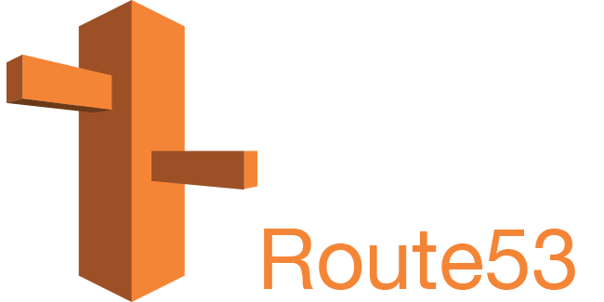
Introduction
Amazon Route53 is a highly available and scalable cloud DNS web service. It helps you to get a website and application up and running

Slide 5
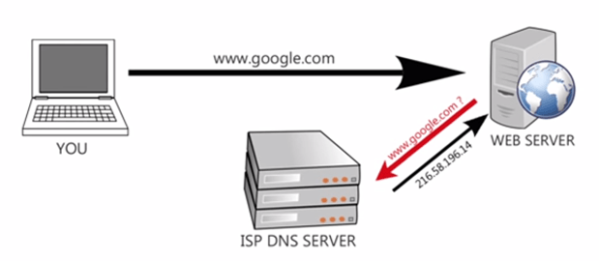
What is DNS?
The Domain Name System is used to resolve human readable hostname into machine readable IP addresses. Without DNS, you would only be able to visit our website (or any website) by visiting its IP address directly, such as http://204.13.248.115.

Slide 6

Features
Register domain names.
Route internet traffic to the resources for your domain.
Check the health of your resources.
Latency based routing
Geo DNS
Weighted round robin
DNS failover

Slide 7

Routing Policies
Simple Routing Policy
Weighted Routing Policy
Latency Based Routing Policy
Failover Routing Policy
Geolocation Routing Policy

Slide 8
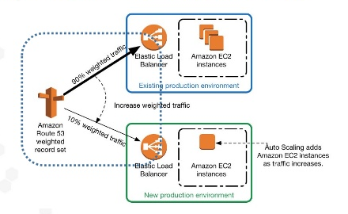
Weighted Routing Policy
Weighted routing lets you associate multiple resources with a single domain name (example.com) or subdomain name (acme.example.com) and choose how much traffic is routed to each resource.

Slide 9
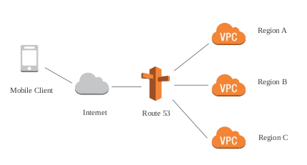
Latency Based Routing Policy
If your application is hosted in multiple Amazon EC2 regions, you can improve performance for your users by serving their requests from the Amazon EC2 region that provides the lowest latency.

Slide 10
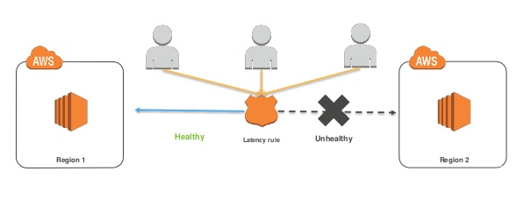
Failover Routing Policy
Failover routing lets you route traffic to a resource when the resource is healthy or to a different resource when the first resource is unhealthy.

Slide 11
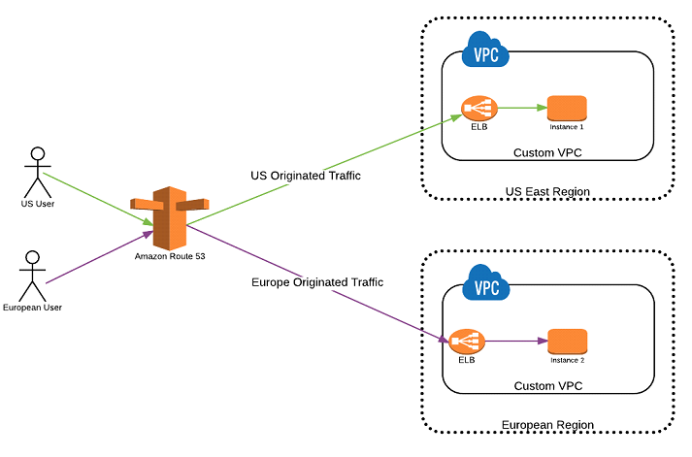
Geolocation Routing Policy
Geolocation routing lets you choose the resources that serve your traffic based on the geographic location of your users, meaning the location that DNS queries originate from.

Slide 12
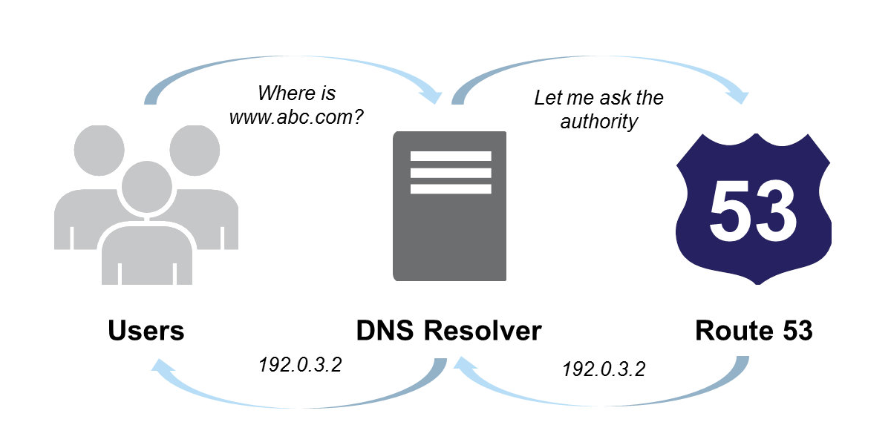
Working of Route 53

Slide 13


Slide 14


